Slide 1


MEDINAV
Tomahawk Tech

Slide 2
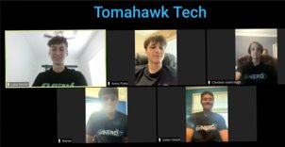
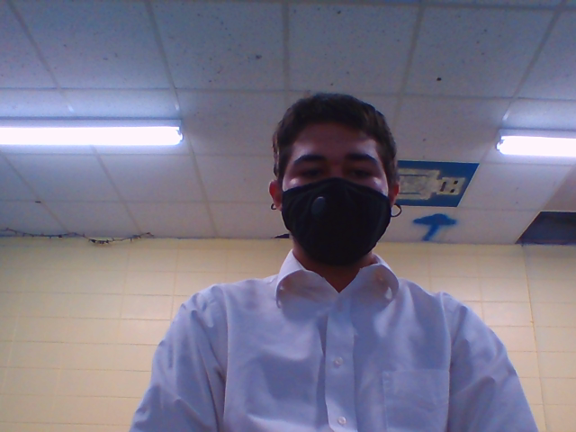
Team
We are Tomahawk Tech, an organization built to solve social problems with modern technological solutions. We were tasked with helping out hospitals who were hit by COVID-19. We created MEDINAV to assist hospitals in managing their supplies, while providing the public with information on these hospitals.

Slide 3
The Problem
Hospitals were among the hardest hit operations by COVID-19. Equipment quickly ran out and hospitals were forced to turn away patients. People were unsure on whether or not they would be accepted by health institutions. Hospitals need a better way managing their time and equipment, while letting the general public know what is open to them.

Slide 4
MEDINAV
MEDINAV is an innovative app created for nurses and doctors with the goal of tracking essential equipment/utilities.
Uses a system of Admins and Members
Accurately tracks available blood, beds, PPE, and ventilators.
Is open to the public for

Slide 5
Community Impact
Collective, real time status
Paperless file system, resulting in less germ spread.
Informed public
Better time managment

